Slide 1
Minor Account In BPP Process
Reliance Securities LTD

Slide 2
Account Opening Process (NOTE)
A minor account can open an account with RSL and can operate only in Cash Segment with the applicable restrictions as listed below:
Minors cannot buy shares and government securities.
Minors cannot place any intraday and F&O orders.
Minors can only sell eligible holdings from their demat account.
Minors can apply for IPOs, buybacks and takeovers.
Minors can invest in mutual funds.
It is mandatory for a minor to have an active trading account of a guardian in RSL to have his / her account opened in RSL.
When a minor turns major (18 years old), a fresh KYC is to be carried out, and the minor account shall be converted to an individual account.

Slide 3
Account Opening Process (NOTE)
Account (Trading & Demat) will be opened in sole holder’s name only.
A minor is required to provide the following set of documents for opening an account (Currently Offline) in RSL
Account Opening Form (AOF) and Know Your Customer (KYC) form.
Copy of Minor's PAN Card
MINOR POA - Aadhaar card of minor along with Aadhaar consent (to be
Signed by the guardian)
Minor’s Bank Proof
Birth Certificate or School Leaving Certificate, Mark Sheet issued by Higher ` Secondary Board, or Passport
Guardian’s PAN Card
Guardian’s Bank Proof
Guardian's RSL Trading & Demat Account Number (mandatory)
Guardian’s POA - Aadhaar card of the guardian along with Aadhaar
Consent
The minor account shall be opened within 48 hours after successful verification of documents.

Slide 4

Selling in Minor Account (NOTE)
Only stocks acquired through the following route shall be allowed to be sold in minor account.
IPO
Gift from Guardian’s DP account linked and maintained with RSL
Transfer from Guardian’s DP account linked and maintained with RSL
Donation from Guardian’s DP account linked and maintained with RSL
Minor shall be allowed to trade from his / her own login in Tick pro or Tick Web only. Minor can also place trades from Call & Trade desk.

Slide 5
Stock Pledge and Fund transfer & Withdrawal (NOTE)
Stock Pledge
Margin pledging shall not be allowed in Minor’s account.
Fund transfer & Withdrawal
Funds can be added and can also be withdrawn from the minor account. Funds have to be transferred from linked bank of the minor only and all withdrawals shall be credited to the link bank of the minor only.
The funds transferred to client account cannot be used to buy securities. It can only be used to pay the applicable charges like transaction charges, transfer fees, DP charges etc.

Slide 6
IMPORTANT NOTE
Applicable for Opening:
a) Minor Trading and Demat Account b) Trading Account for an Existing Minor Demat Account
Number of Signatures: 20 signatures of the guardian required.
Process (whom to send/ where to send) - As per existing process
In Minor account, nominee cannot be opted.

Slide 7
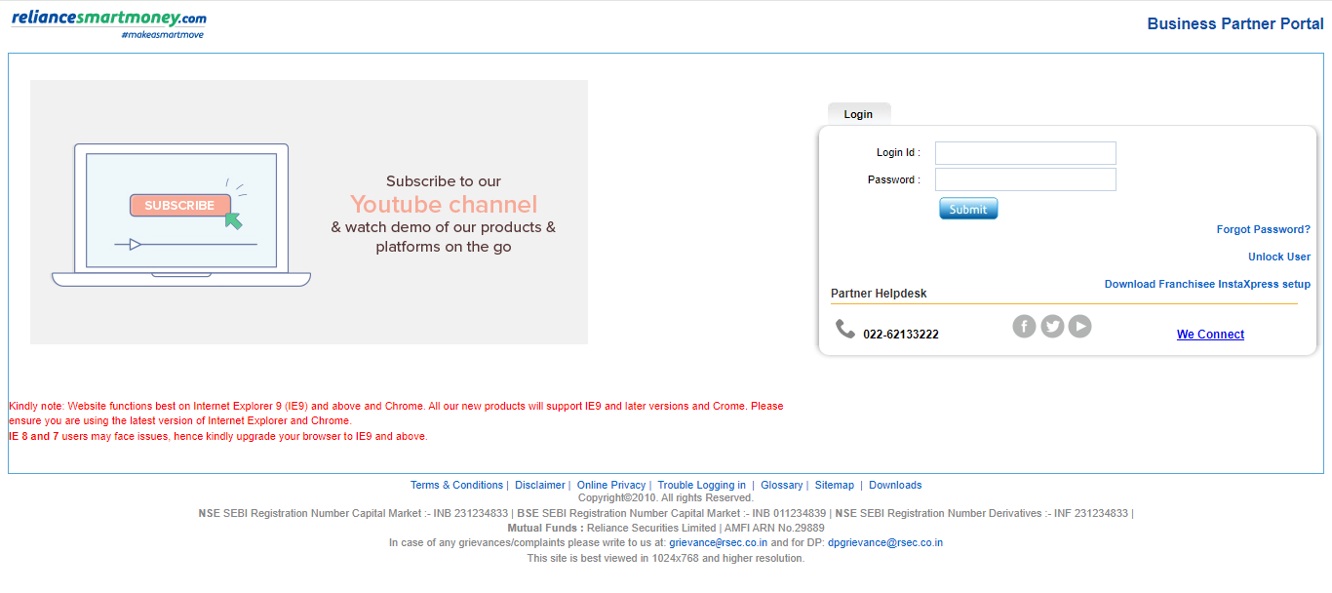
BPP Login Page
Partners must log in to the BPP system and enter their Login ID and Password. Click the Submit button.

Slide 8
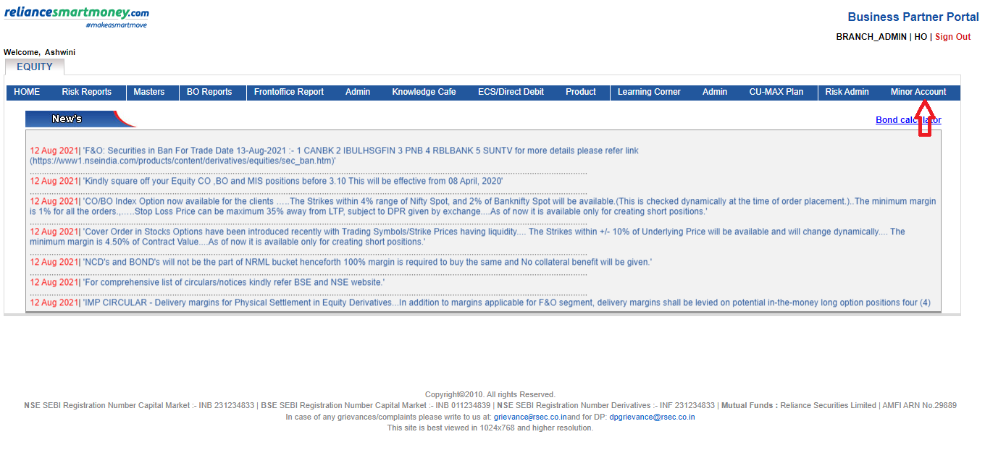
Dashboard
Upon successful login, partners will be able to see the Minor Account feature. Click on the Minor Account option located on the extreme right.

Slide 9
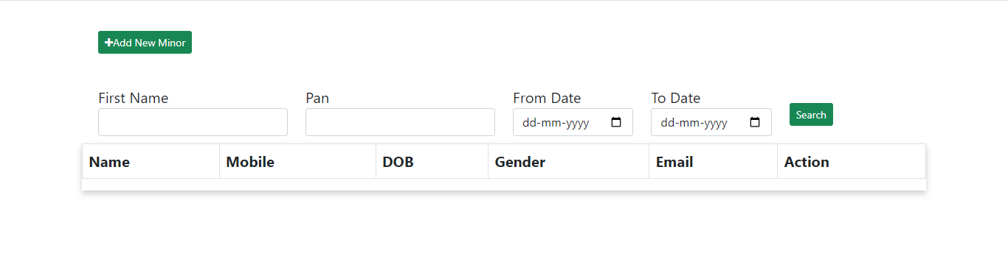
Managing Existing Minor Accounts
To check the status of existing minor accounts.
Enter the following details:
First Name
PAN
From Date
To Date and then Click the Search button

Slide 10
Adding a New Minor Account
To add a new minor account, Click on the +Add New Minor button.

Slide 11
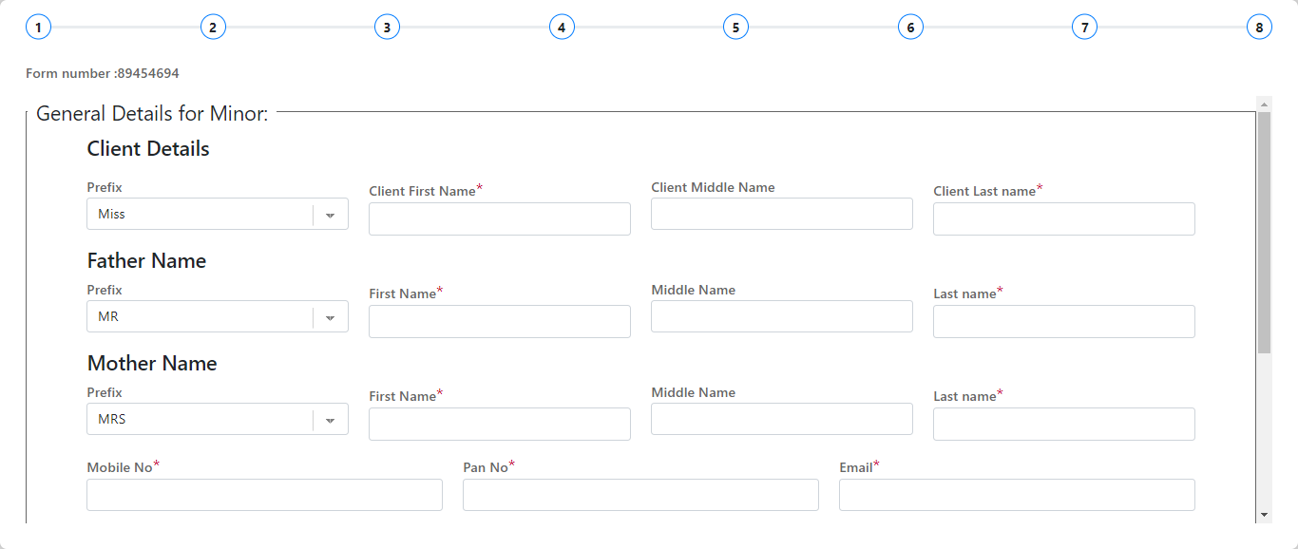
Stages for Adding a Minor Account Stage 1- General Details for Minor Page
Enter general information about the minor.
Fields:- Select Salutation(Prefix)from the drop-down,
Client's Details (First Name, Middle Name, Last Name)
Father's Name, Mother's Name
Mobile Number, PAN, Email

Slide 12
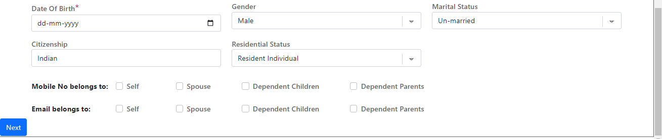
Stages for Adding a Minor Account Stage 1- General Details for Minor Page
Enter Date of Birth, Gender, Marital Status, Citizenship, Residential Status
Tick the Checkboxes:
Mobile Number belongs to
Email belongs to and then Click Next.

Slide 13
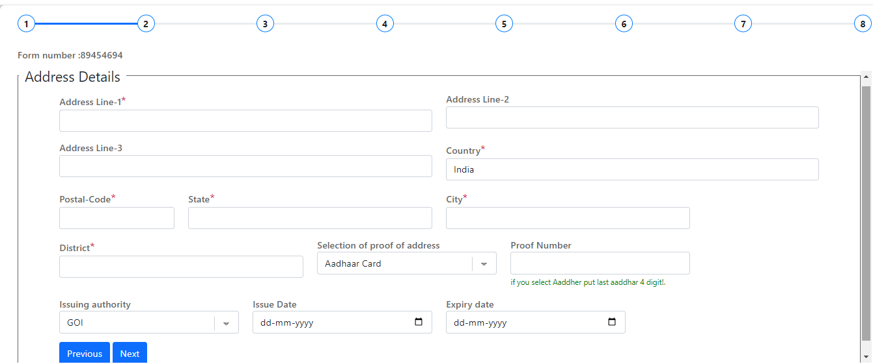
Stage 2: Address Details Page
Enter complete address information of Minor
Select One Proof of Address from the drop-down if selecting the Aadhaar card enter the last 4 digits of the Aadhar number as proof
Select the Issuing authority from the drop-down, select the issue date and expiry date, and then Click Next.

Slide 14
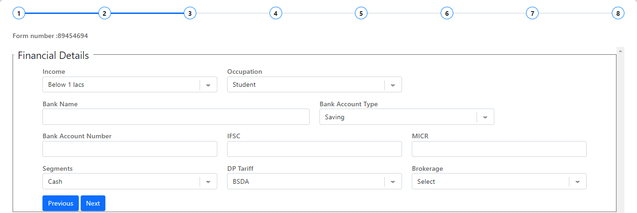
Stage 3: Financial Details Page
Provide financial information for the minor.
Fields:- Income, Occupation, Bank Name, Bank Account Type, Bank Account Number, IFSC, MICR, Segments (DP Tariff: BSDA, NON-BSDA, Lifetime AMC), Brokerage
Click on Next

Slide 15
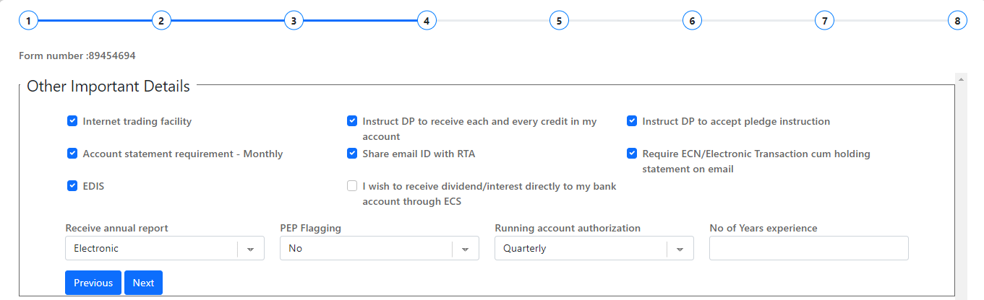
Stage 4: Other Important Details Page
The checkbox of Other Important details is by default ticked
Fill in additional necessary details/Fields.
Fields:- Select Receive annual report from the drop-down, PEP Flagging, Running account authorization, and number of experience
Click on next

Slide 16
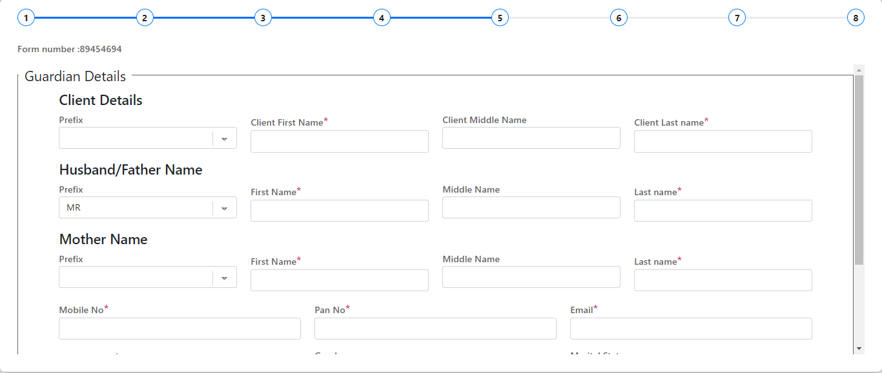
Stage 5: Guardian Details Page
Enter guardian information.
Father's/Husband's Details, Mother's Details
Client's Prefix, First Name, Middle Name, Last Name
Mobile number, PAN, Email.

Slide 17
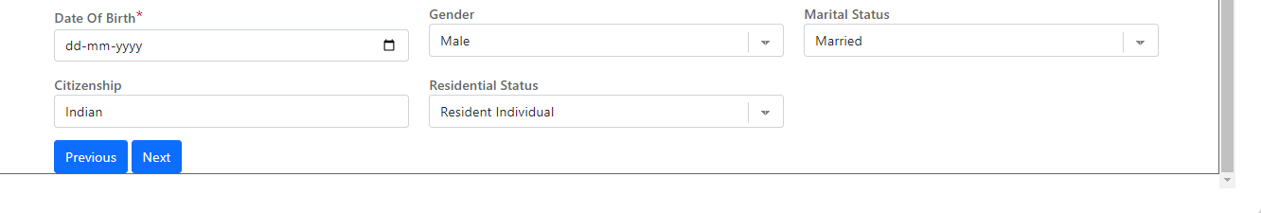
Stage 5: Guardian Details Page
Date of Birth, Gender, Marital Status, Citizenship and Residential status
Click on Next

Slide 18
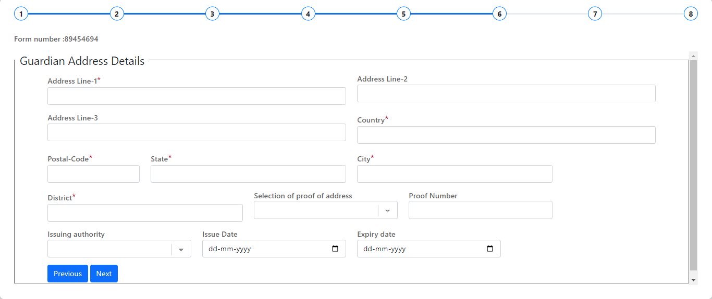
Stage 6: Guardian Address Details Page
Enter the guardian’s address details accurately.
Select One Proof of Address from the drop-down if selecting the Aadhaar card enter the last 4 digits of the Aadhar number as proof
Select the Issuing authority from the drop-down, select the issue date and expiry date
Click on Next.

Slide 19
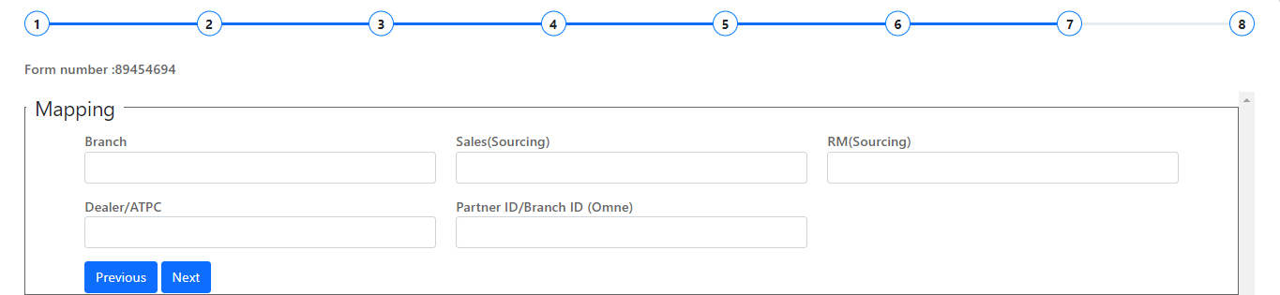
Stage 7: Mapping Page
Enter mapping details for sourcing.
Fields:-
Branch Name
Sales (Sourcing)
RM (Sourcing)
Dealer/ATPC
Partner ID/Branch ID
Click on Next

Slide 20
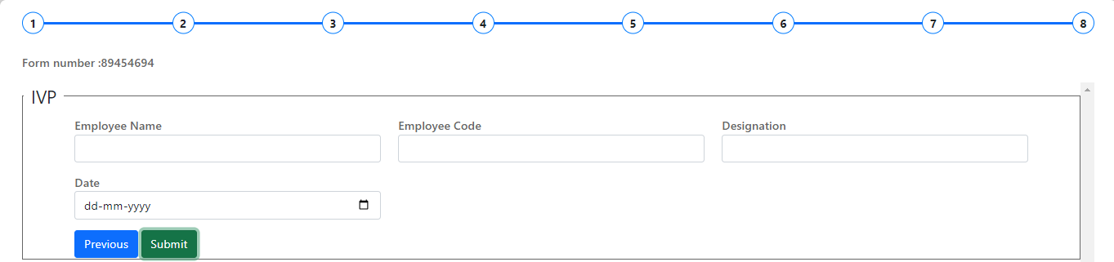
Stage 8: IPV Page
Stage 8 – IPV(In Person Verification)
Enter IPV details for sourcing.
Fields:-
Employee Name
Employee Code
Designation
Date
Click On Submit

Slide 21
Thank You

